Slide 1
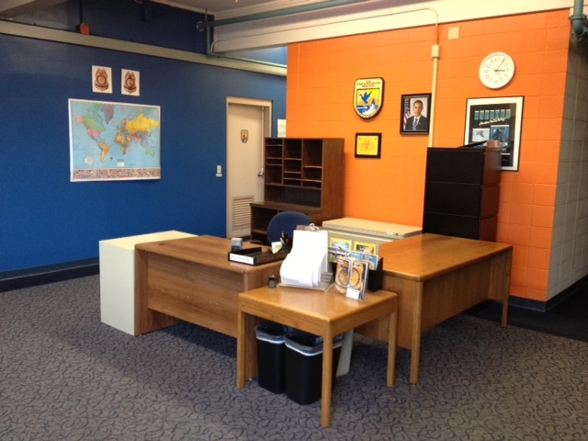
U.S. Fish & Wildlife Service Office of Law Enforcement
Port of Seattle
Notes:
Open 8 am to 4 pm by appointment. Just call and we will be at your service.

Slide 2
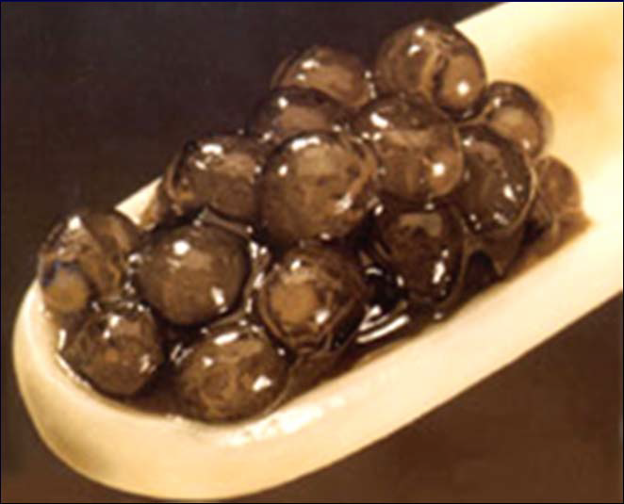
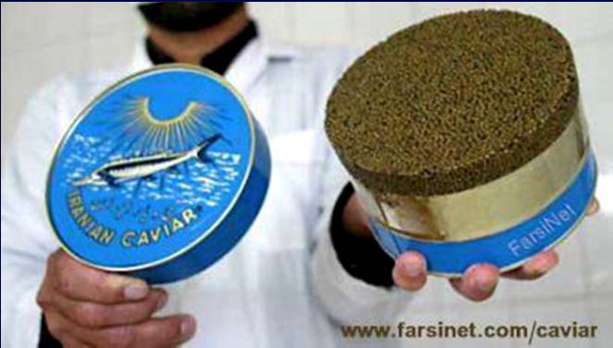
Agenda
Mission
Wildlife vs Domesticated Species
Shellfish and Fishery Products
Permits/Licenses
48 Hour Notices
Declaration methods
Checklist for Brokers/Importers
Finding Information
Common errors
Q&A
Beluga: Huso huso

Slide 3
Mission of the U.S. Fish & Wildlife Service:
Working with others to conserve, protect and enhance fish, wildlife, plants and their habitats for the continuing benefit of the American people.

Slide 4
Mission of the U.S. Fish & Wildlife Service, Law Enforcement:
To protect wildlife and plant resources. Through the effective enforcement of Federal laws, we contribute to Fish and Wildlife Service efforts to recover endangered species, conserve migratory birds, preserve wildlife habitat, safeguard fisheries, combat invasive species, and promote international wildlife conservation.

Slide 5
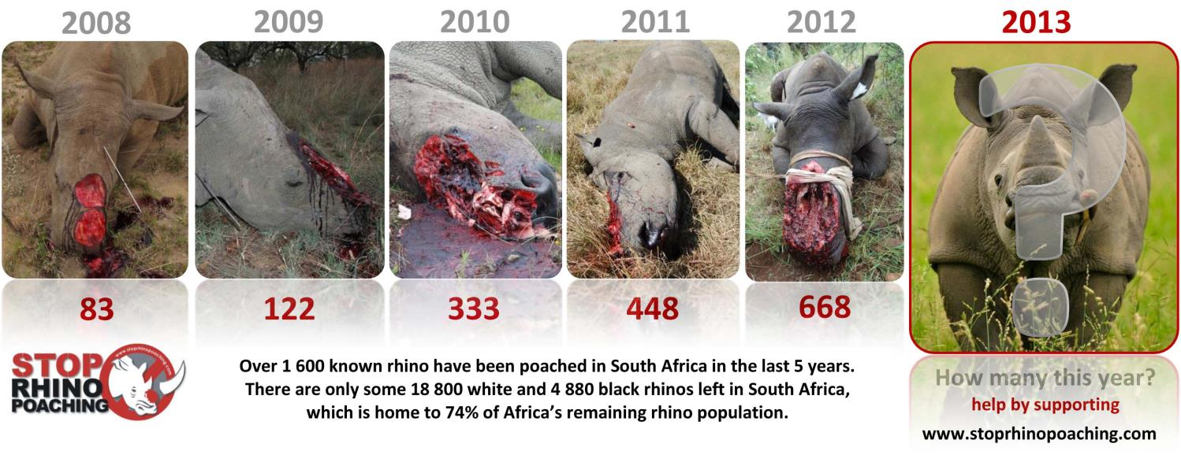
Rhino poaching

Slide 6
Elephant Ivory Poaching

Slide 7
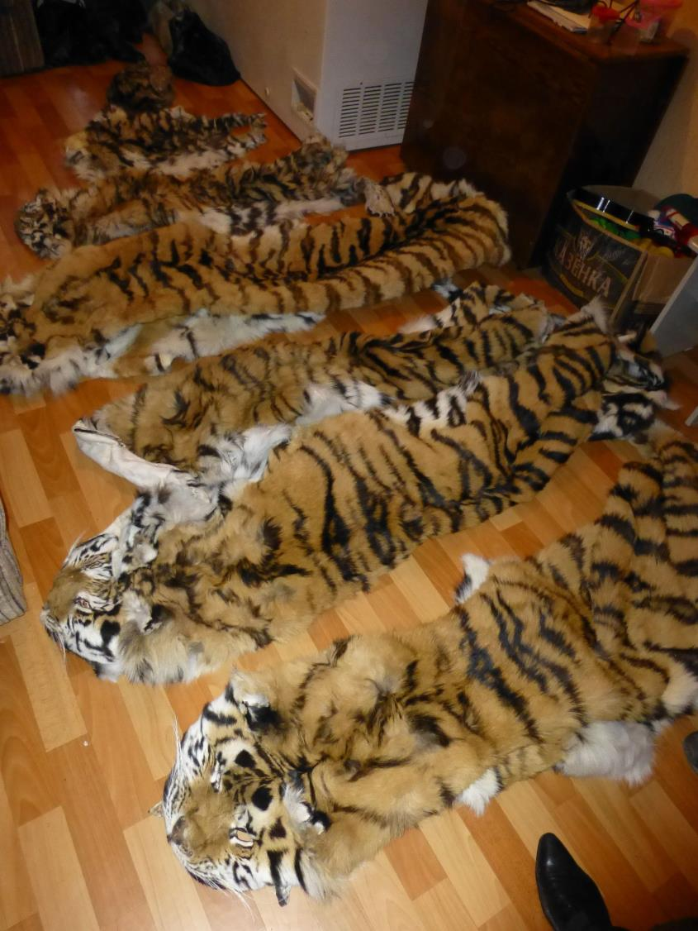
T
Notes:
Tiger Poaching

Slide 8
What is Wildlife?
USFWS definition:
Wildlife is any wild animal, whether live or dead, including without limitation any wild mammal, bird, reptile, amphibian, fish, mollusk, crustacean, arthropod, coelenterate, or other invertebrate, whether or not bred, hatched, or born in captivity, and including any part, product, egg, or offspring thereof.
Notes:
Our definition of what is wildife

Slide 9
Shellfish and Fishery Products
Shellfish – An aquatic invertebrate with a shell; includes any part, product, egg, or offspring whether or not included in a manufactured product or in a processed food product (i.e.: oyster, clam, mussel, scallop, cockle, abalone, conch, whelk, marine snail, lobster, crayfish, prawn)
Fishery Product – A non-living fish; includes any part, product, egg
or offspring whether or not included in a manufactured product
or a processed product.

Slide 10
Shellfish and Fishery Products
Examples of Animals that are NEVER exempt
(i.e. Service requirements must ALWAYS be met):
Squid
Octopus
Cuttlefish
Land Snails (escargot)
Sea Urchins
Sea Cucumbers
Frogs
Alligators
Sturgeon caviar
Queen conch
Shark fins (from protected sharks)

Slide 11
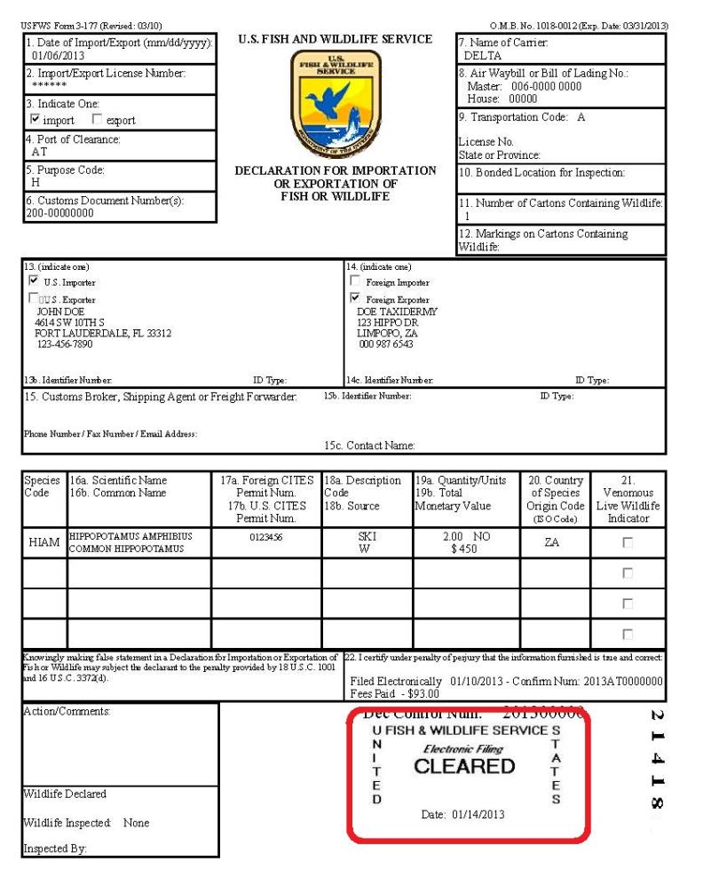
USFWS Declaration (Form 3-177)
eDecs (electronic) or hard copy
Ensure the declaration is stamped “CLEARED”
Must be “CLEARED” before released by CBP

Slide 12
Cleared

Slide 13
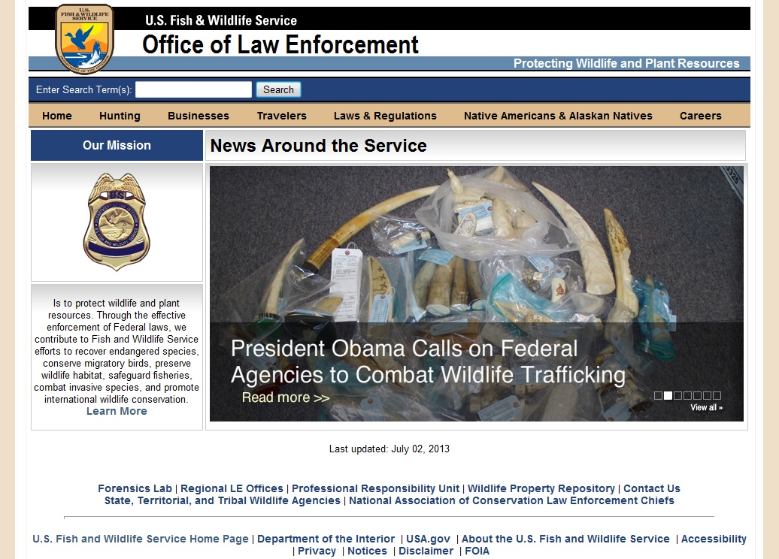
www.fws.gov/le

Slide 14
What can I find on the www.fws.gov/le that will help me?
Public Notices and Alerts: Recent changes, clarification on regulations, etc.
Wildlife Inspection Offices: Mailing info, phone numbers, identified as designated ports.
Other Agencies information: CDC, USDA
Laws and Regulations: Wildlife (import/export/re-export 50 CFR Part 14)
Import/Export (I/E) license/Designated Port Exception Permit (DPEP) information: Links, regional office addresses, applications.
Importing & Exporting shellfish and fishery products
CITES information: Requirements, validations, rules.
Fact sheets: Import sport hunted trophies
eDec: User’s manual, filing instructions, paper 3-177, license information, Low Risk Fee Exemption Program.
Importing your commercial shipment
Information for Businesses

Slide 15
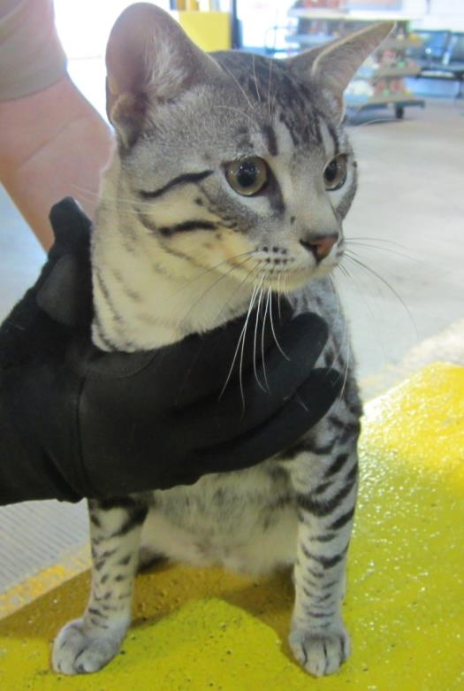
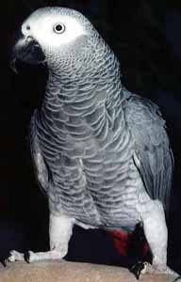
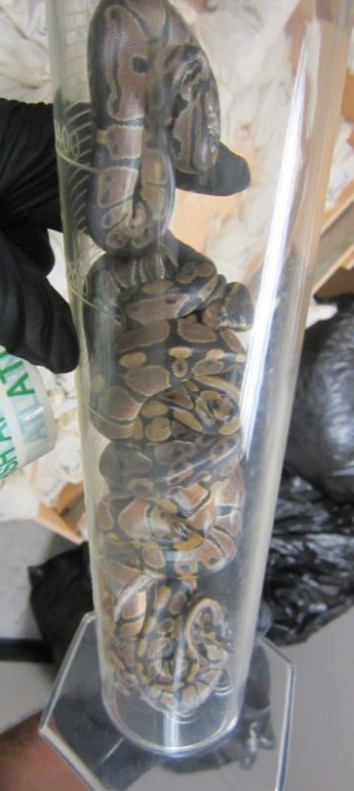
Live Wildlife
Savannah Cat African Grey Royal Pythons

Slide 16
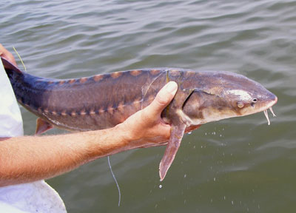
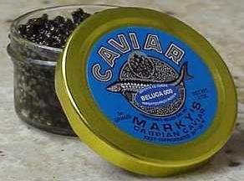
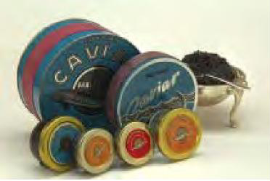
CAVIAR
Shortnose Sturgeon (Acipenser brevirostrum)

Slide 17
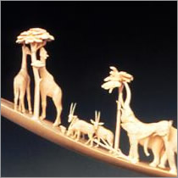
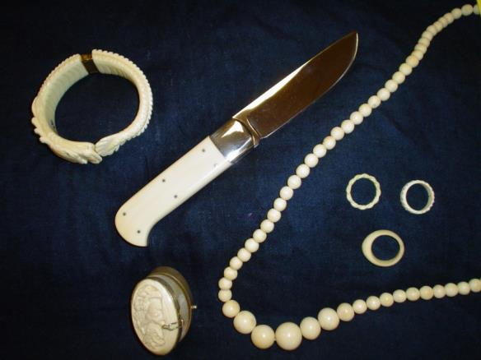
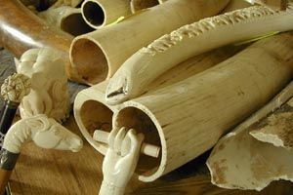
Ivory Products
A number of species such as warthog, walrus, hippo, sperm whale, and killer whale look similar to elephant ivory. Elephant ivory is most common on piano keys, scrimshaw, jewelry and instruments.
Credit: USFWS

Slide 18
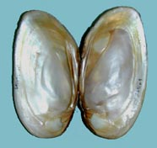
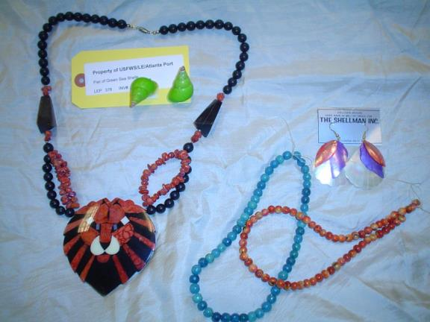
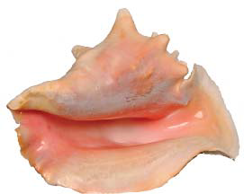
CORAL & SHELL PRODUCTS
Coral jewelry
Whole shells and products made from shells such as jewelry, shell buttons, handicrafts, furniture with shell inlay, musical instruments, etc.
Mother of pearl
Credit: NOAA
Tami Heilemann/FWS

Slide 19
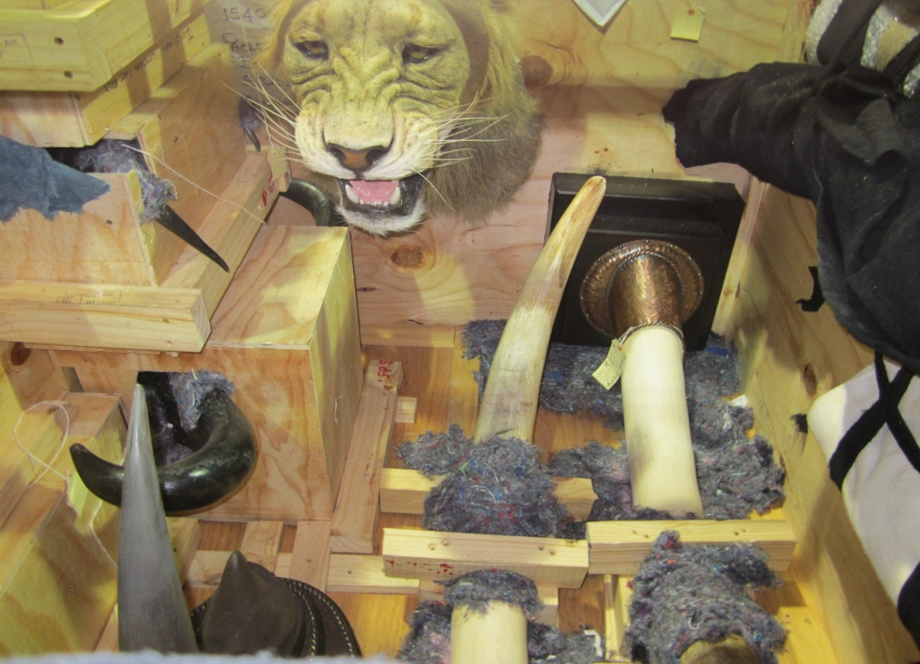
Hunting Trophies
Any hunting trophy requires FWS declaration, regardless of species.

Slide 20
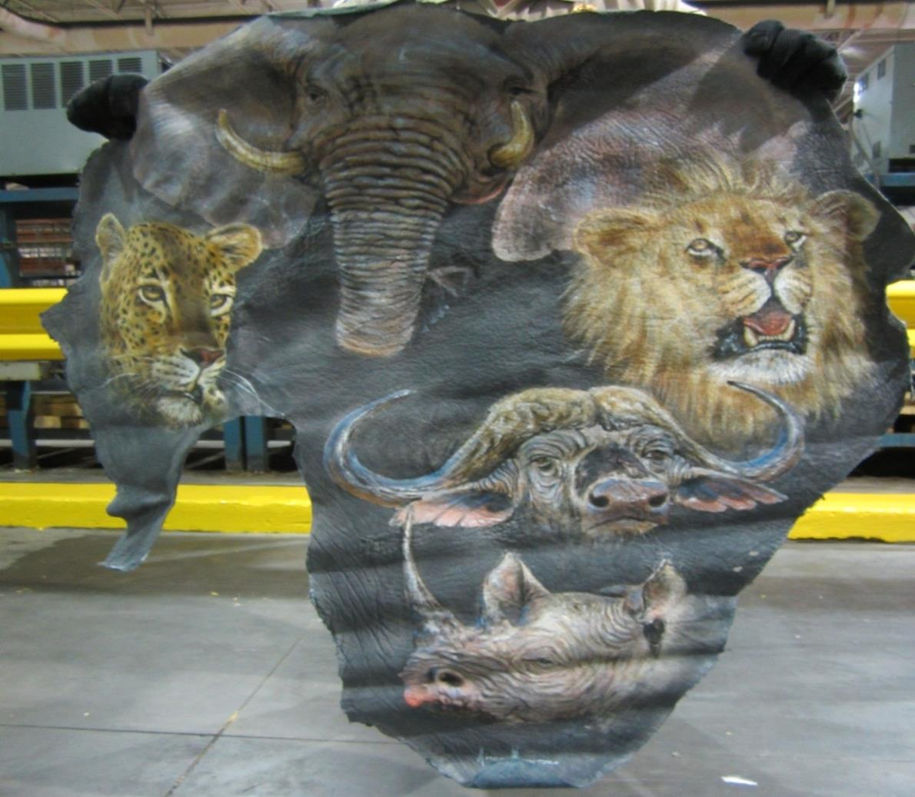
“Big 5” painting on Elephant Ear – CITES “P” Permit

Slide 21
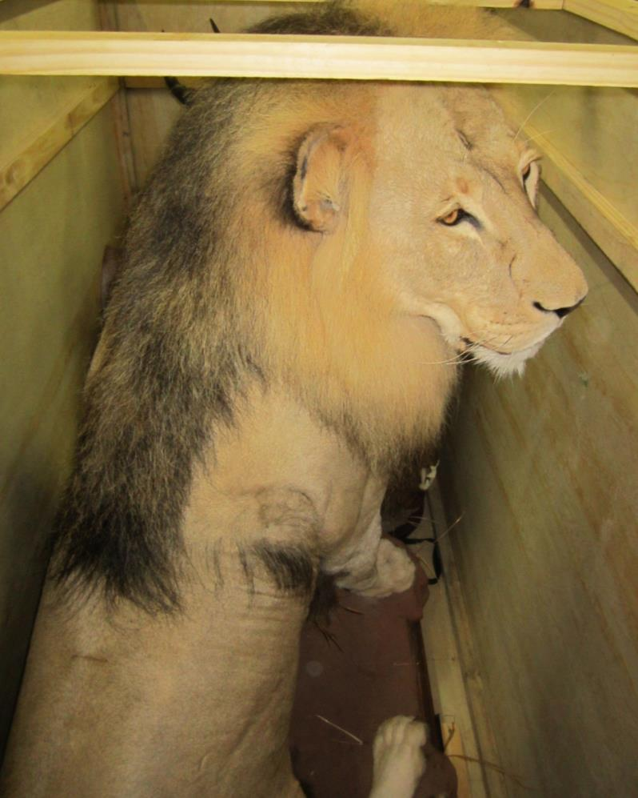
Male Lion- full mount –CITES “H” Permit

Slide 22
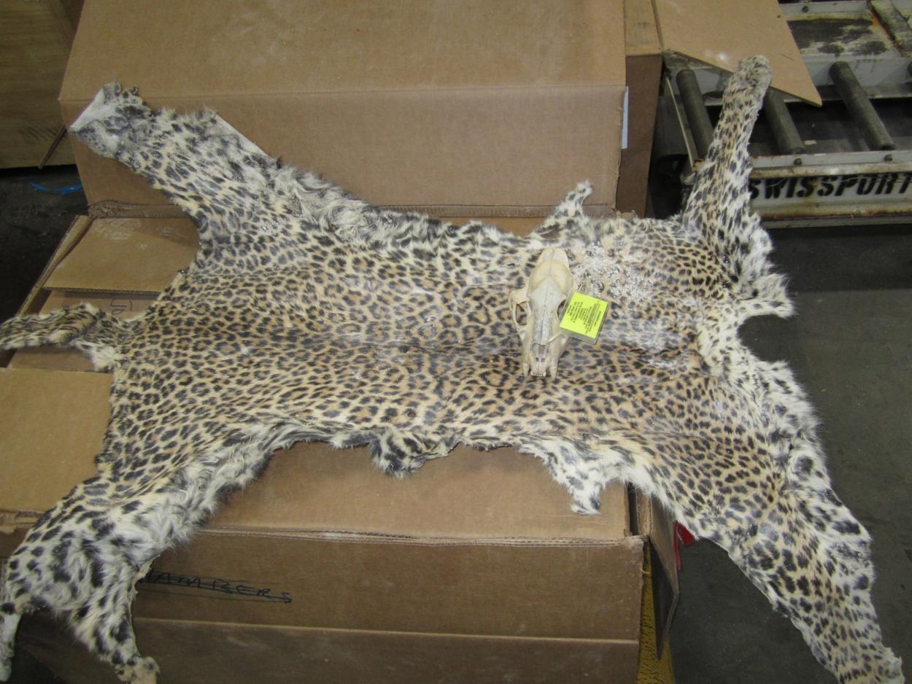
Leopard skin and skull- CITES “H” and U.S. Import Permit

Slide 23
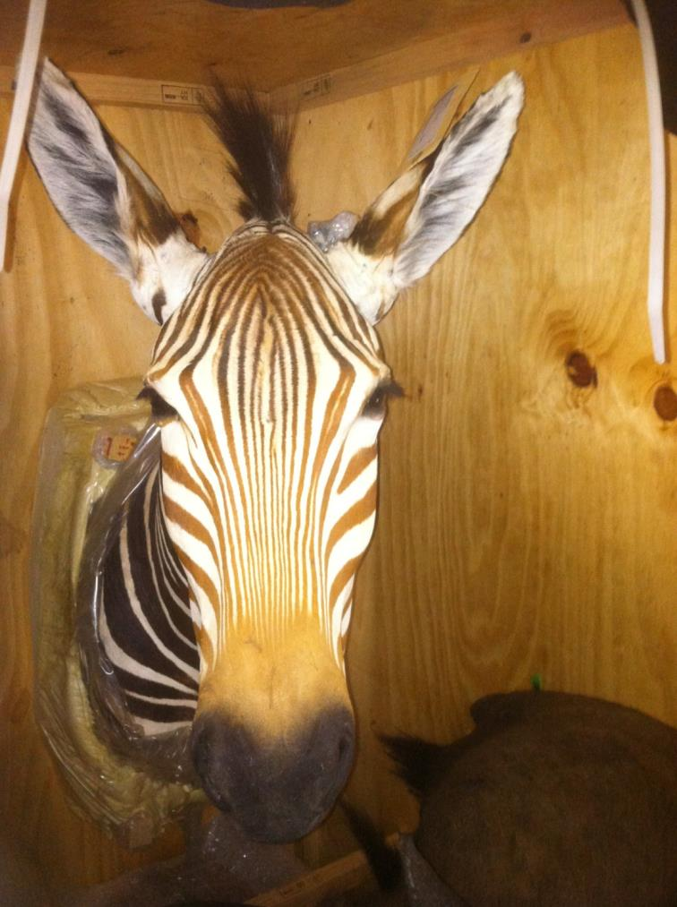
Zebra – Shoulder Mount –CITES “H” Permit

Slide 24
Caviar- CITES “T”

Slide 25
When in doubt, call an Inspector Office Hours: Monday-Friday (excluding Federal holidays) 8:00AM-4:00PM 206-429-2198 (office) John_Goldman@fws.gov (Supervisor) Marcy_Jullian@fws.gov Ashley_Skeen@fws.gov

