Slide 1
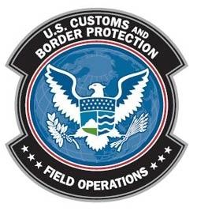
Carrier Conveyance Contamination Initiative
Mikel Tookes
Deputy Executive Director
Agriculture Programs and Trade Liaison
March 18, 2014
Notes:
1

Slide 2
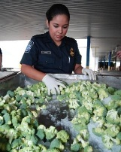
Carrier Conveyance Contamination
Initiative
Protect United States Agriculture from Threats
Facilitate Travel and Trade
Create Less Holds and Reduce Delays
Identify Best Practices for Industry
Provide Communication and Outreach
Increase Training and Detection
Proper Treatment
Notes:
2

Slide 3
What is Conveyance Contamination?
Contamination is the presence of a minor and unwanted constituent (contaminant) in a material, in a physical body, in the natural environment, around and in a workplace.
In biological sciences, accidental introduction of "foreign material” (contamination) can cause serious harm to the United States agriculture and natural resources.
Mikel Tookes
Deputy Executive Director
3

Slide 4
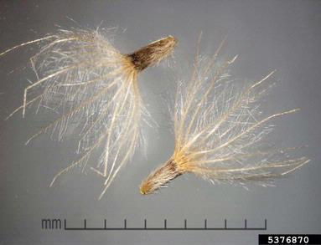
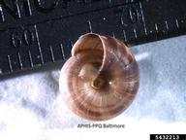
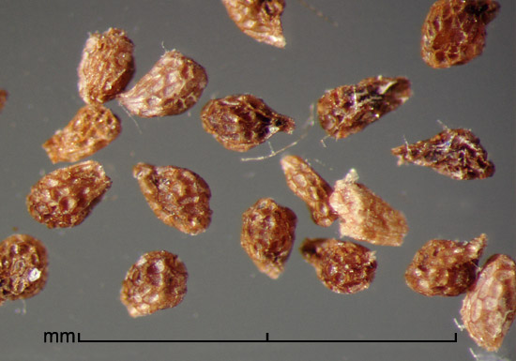
Carrier Conveyance Contamination
Initiative
Inform Trade of the potential threat contaminants present to the United States.
Describe CBP’s efforts to prevent entry of contaminants.
Identify best practices the industry can take to ensure
conveyance(s) are free of contaminants.
Tridax procumbens
Coatbuttons
Cernuella cisalpina
Maritime gardensnail
Orobanche spp.
Broomrape
Notes:
4

Slide 5
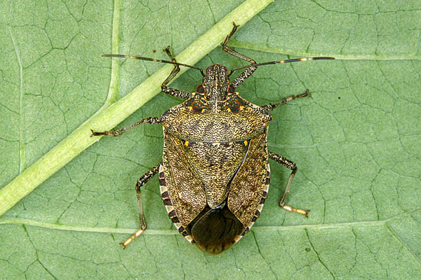
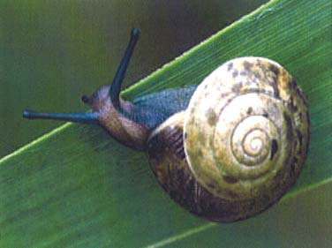
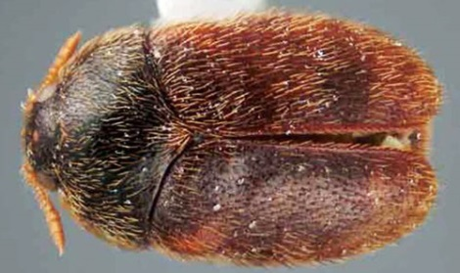
Carrier Conveyance Contaminants
Hitchhiking Pests
Hitchhiking pests are organisms that are inadvertently introduced into the United States by their attachment or inhabitation of carrier conveyances, not though infestation of the imported commodity or Wood Packing Material.
Conveyances with actionable hitchhikers must be put on hold.
Hitchhiker Found in Burlap Sacks
Accidentally Introduced into the US in Packing Crates
Actionable Snails Found on Containers
Notes:
5

Slide 6
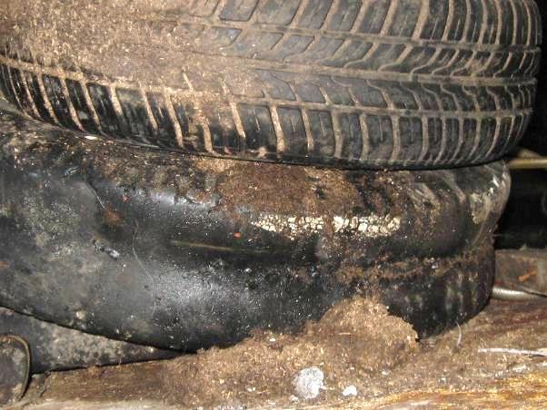
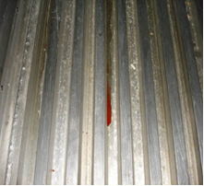
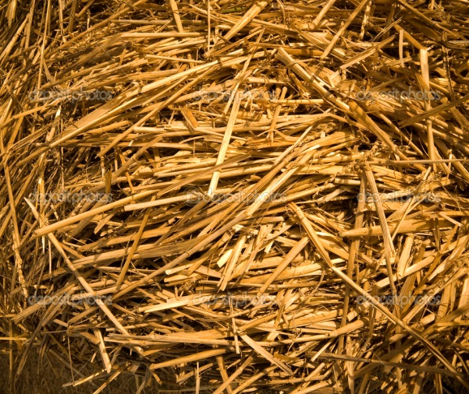
Carrier Conveyance Contaminants
Vectors of Foreign Animal Disease
Conveyances contaminated with animal feed such as hay, or by-products of animal livestock such as manure, blood, fluids, or urine, risk introducing Foreign Animal Diseases into the United States.
Tires Contaminated with Manure
Trailer with Animal Blood
Animal Feed Left in Trailer

Slide 7
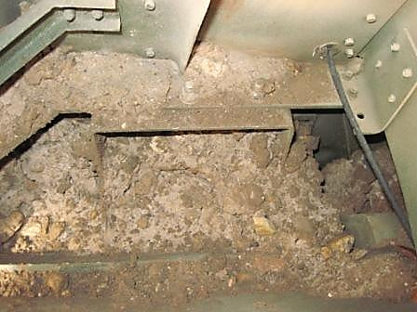
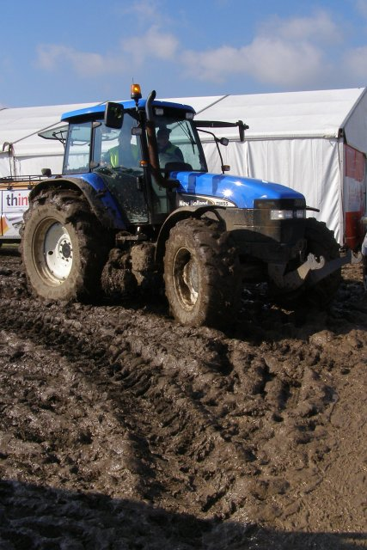
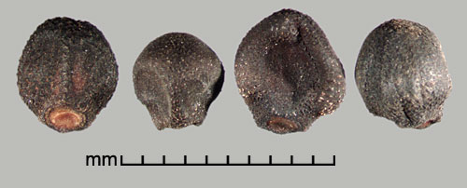
Carrier Conveyance Contaminants
Soil
Contamination from soil can act as an unintentional pathway for Federal Noxious Weeds, Foreign Animal Diseases, animal and plant viruses, nematodes, bacteria, and fungi.
Tire Contaminated with Soil
Federal Noxious Weeds
Cargo Carrier Contaminated with Soil

Slide 8
Carrier Conveyance Contamination
Enforcement
(Cleaned If Necessary) and Released for Commerce
No Contaminant Found
Carrier Conveyance Selected for Inspection
Contaminant Can Be Removed Via Cleaning and Disinfection
Discovery of Contaminant
Contaminant Must be Identified- Shipment Put on Hold

Slide 9
Carrier Conveyance Contamination
Enforcement
Shipment on Hold- Waiting for Final Identification
Shipper Elects to Return Shipment to Country of Origin Before Pest ID
Contaminant Identified and Requires No Action
Contaminant Identified and Requires Action
EAN Issued and Shipment is Re-Exported
Conveyance Released into Commerce
EAN Issued for Treatment or Re-Exportation

Slide 10
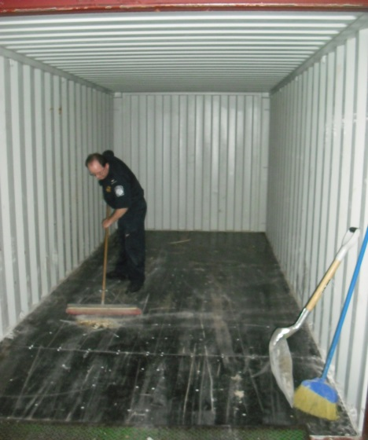
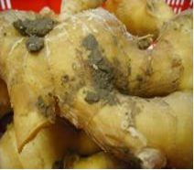
Best Practices for Trade
Sweep, vacuum, or wash conveyances prior to loading.
Ensure cargo is clean and free of contaminants.
Visually inspect conveyances
for contamination.
Train employees to identify and remove contamination.
Soil Contaminant on Ginger
Sweeping Out a Container
Notes:
10

Slide 11
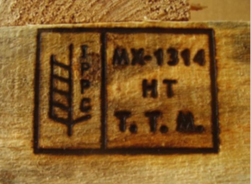
Wood Packaging Material (WPM)
  Inform Trade of the potential threat wood boring insects may pose to the United States.
  Describe CBP’s efforts to prevent entry of wood boring pests.
              Identify best practices industry can
              take to ensure wood packaging
              material is free of wood boring pests.
Damage caused by wood boring pests
ISPM 15 Stamp
Larval gallery
Notes:
Notes:
Threats posed by wood boring insects on WPM:
Significant pest risks associated with WPM include Asian Longhorn Beetle (ALB) and Emerald Ash Borer (EAB), which damage/destroy American agricultural resources.
ALB -71 billion trees valued at over 2 trillion dollars and over $800 M eradication cost.
EAB-has killed tens of millions of ash trees in various states within the United States.
CBP’s efforts to prevent entry of wood boring pests on WPM has employed several tools including training and outreach:
WPM training for CBP Agriculture Specialists, CBP Officers, and CBP Port Management
A power point presentation provided to Industry/Trade and a facilitator’s guide on WPM
Outreach on WPM to various stakeholders
11

Slide 12
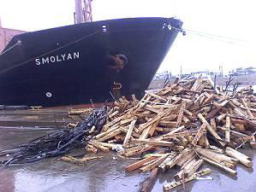
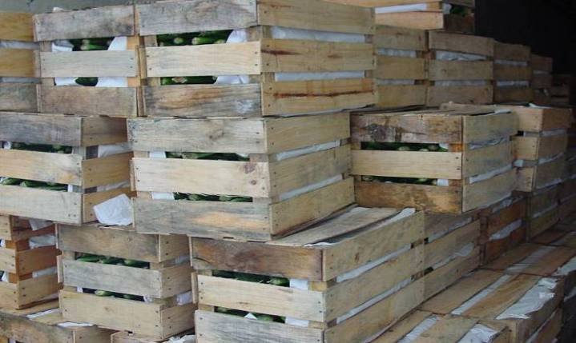
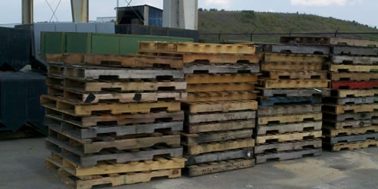
Wood Packaging Material (WPM)
Bracing and Dunnage
Crates
Wooden Pallets
Notes:
12

Slide 13
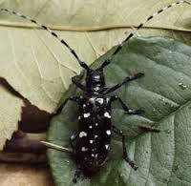
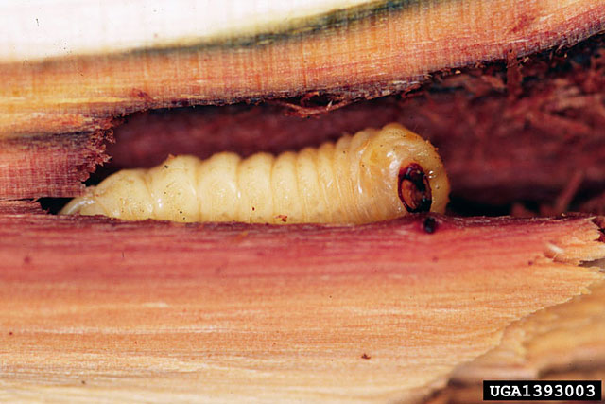
Best Practices for WPM in Trade
Ensure all WPM is ISPM 15 compliant.
Educate your supply chain on ISPM 15 requirements.
Know alternatives to WPM, such as plastics or metals.
WPM that is non-compliant must be re-exported.
Train employees to identify signs of insect infestation.
Asian Longhorn Beetle
ALB Larva
Notes:
13

Slide 14
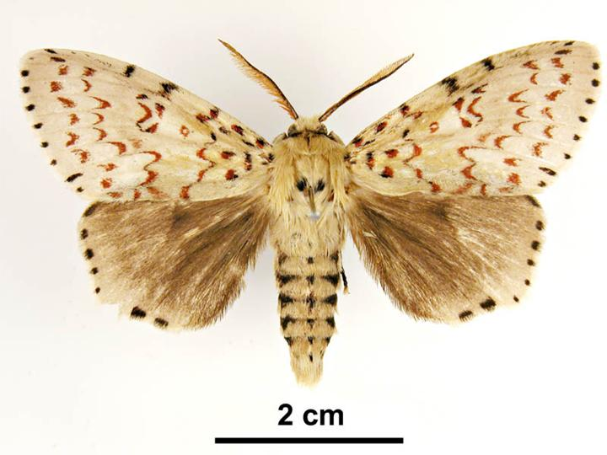
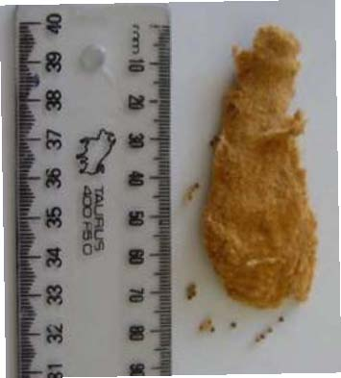
Asian Gypsy Moth (AGM) for Trade
Indicate the potential threat the AGM threat poses to natural resources of the United States.
Describe CBP’s efforts to prevent the establishment of the AGM.
Identify the best practices the industry can take to ensure freedom of AGM on their conveyance(s).
Lymantria dispar
AGM Egg Mass
Notes:
14

Slide 15
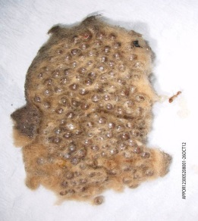
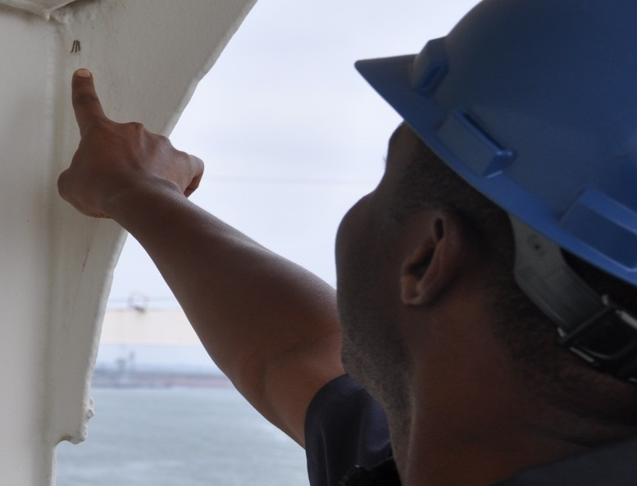
Asian Gypsy Moth (AGM) for Trade
AGM is known to attach to vessels operating in Korea, Japan, China and East Russia during outbreak periods.
AGM larvae consume more than 500 plant species.
Adults can fly up to 25 miles per day.
AGM females disperse eggs across
interior woodlands, which threaten
economic/natural resources.
Average egg masses can be as small as a small as a dime, and may yield hundreds of offspring.
Notes:
15

Slide 16
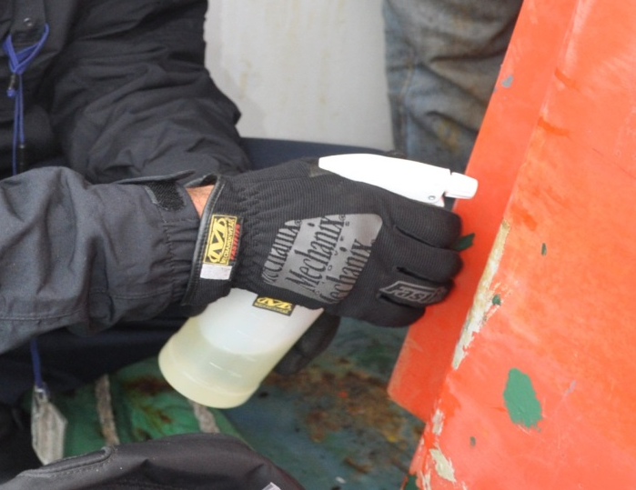
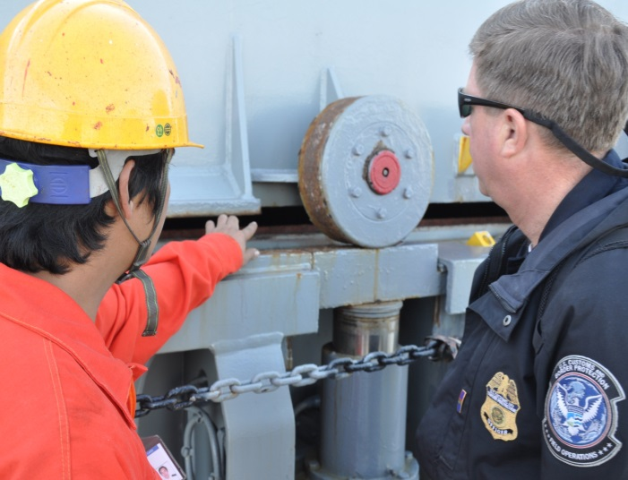
Best Practices for AGM in Trade
CBP Agriculture Specialists inspect high risk vessels based on itinerary/history to prevent AGM introduction.
Trade partners can encourage vessel personnel to note when Asian ports are active with AGM.
Operators can reinforce the need for crew to conduct self inspections prior to arrival in U.S. waters.
Notes:
16

Slide 17
Best Practices for Trade
Summary
Provide personnel with training to detect contaminants.
Comply with regulatory precautions to ensure that all WPM is ISPM 15 compliant.
Perform visual inspections of conveyances frequently before arriving in the United States.
Clean and disinfect conveyances in between visits to animal production facilities and prior to arriving in the United States.
Obtain pre-departure certification for ships (AGM).

Slide 18
Agriculture Programs Trade Liaison
QUESTIONS?

